Slide 1

Cyclistic Case Study
Alice Portes
April 2025

Slide 2
Problem:
Goal:
How can Cyclistic convert casual riders into annual members?
Help Cyclistic analyze usage patterns to better understand how annual members and casual riders differ, in order to design more effective marketing strategies

Slide 3
Analytical goals
How do annual members and casual riders
use Cyclistic bikes differently?

Slide 4
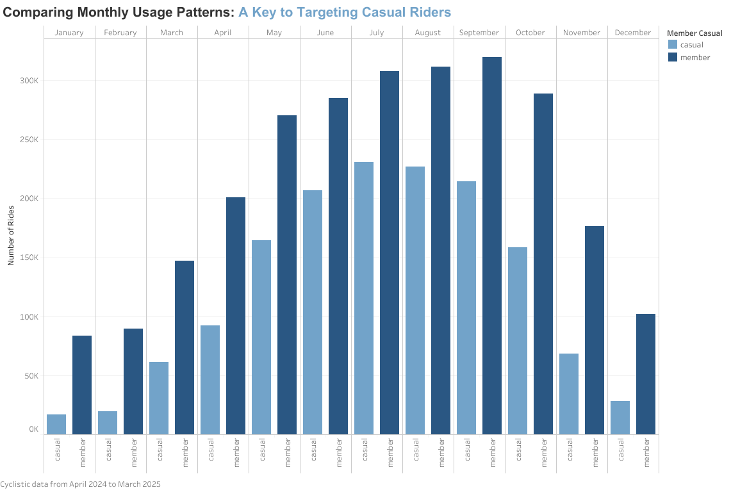
Summer trend
Casual riders and annual members show a significant increase in bike usage during the summer months

Slide 5
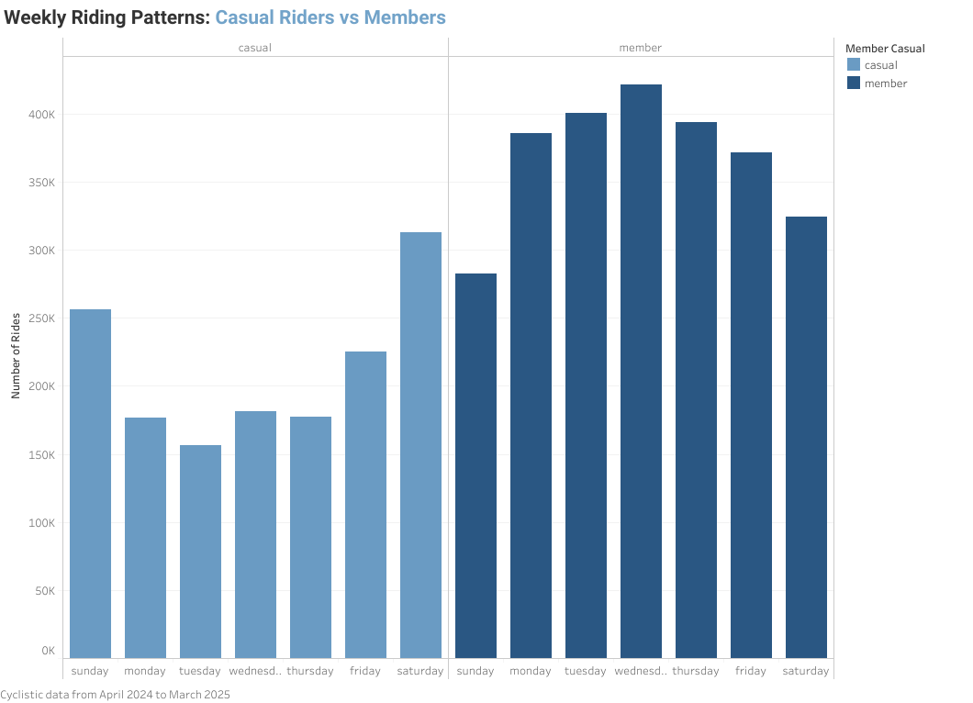
weekend VS weekdays
Casual riders exhibit the highest usage on weekends. In contrast, annual members ride more frequently on weekdays.

Slide 6
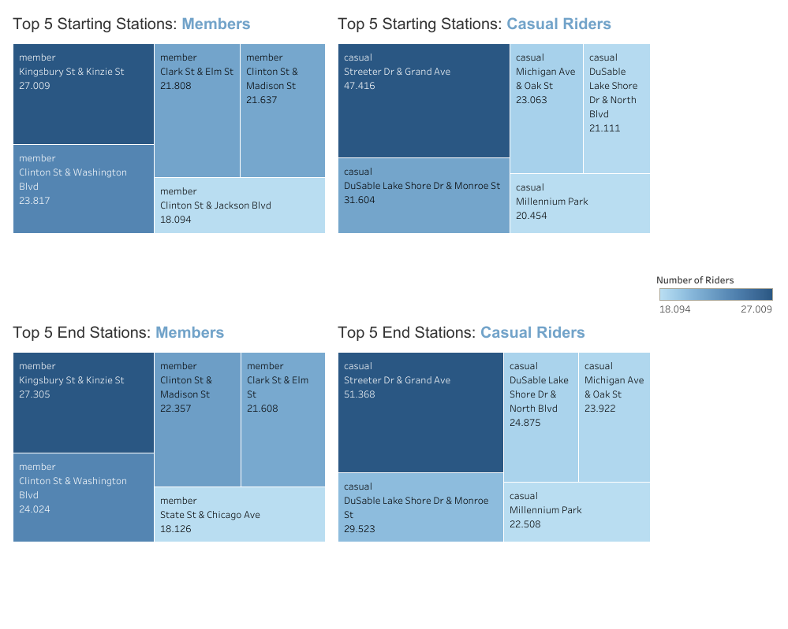
Distinct preferences but strong patterns
Despite diferences in trip purpose or rider type, these stations act as key hubs within the bike-sharing network

Slide 7
Time to act!
1: Leverage Seasonal Peaks to Target Casual Riders - Launch seasonal promotions and campaigns during late spring and summer to convert casual riders into members.
2: Develop Weekend Strategies - Introduce partnerships with tourist attractions to appeal to casual riders and access to coupons at restaurants and events to enhance their experience.
3: Optimize and Enhance Services Around Key Hub Stations - Attract casual riders by transforming their favorite stations into marketing hotspots, add eye-catching materials, easy sign-up QR codes, and irresistible first-ride rewards.

Slide 8

Thank You.

